Slide 1
Terms and Terminology

Slide 2
Epoch
Definition:
A complete pass of the training dataset during machine learning model training can be referred to as an epoch.
Usage:
The model updates its weights and biases by observing and learning the full dataset with the optimizer applied at each epoch.
Example:
If you set 10 epochs to the entire training dataset, the model will loop 10 times to update its model parameters.

Slide 3
Batch
Definition:
A subset of the training dataset that is used to update model parameters during an iteration.
Usage:
Mini Batch is used to update weights and biases at each iteration without using each individual sample (SGD) or entire dataset (Batch Gradient Descent) for efficient computation and stability.
Example:
If your training dataset contains 1000 samples and a batch size of 32 is selected, each iteration will take 32 samples to update the model parameters.

Slide 4
Iteration
Definition:
When the model parameters are updated in one batch of training, it is called iteration.
Usage:
The model returns predictions at each iteration of the current batch to compute the loss for computing gradients and thus updating model parameters.

Slide 5
Learning Rate
Definition:
The learning rate is the step size for updating model parameters during optimization.
Usage:
If the learning rate is too high, it will cause larger updates of model parameters towards faster convergence which may avoid the optimal solution.
Example:
Depending on the optimizer and the problem, the learning rate can be chosen from 0.1 to 0.0001.

Slide 6
Gradient Descent
What is Gradient Descent?
It is an optimizer that minimizes the cost or loss function in deep learning models.
The cost function provides the result of the prediction level of the model.
Gradient descent updates model parameters to obtain optimal values ​​by minimizing the cost function results.

Slide 7
Why Are We Using Gradient Descent?
Optimization:
Optimal model parameters can be found to minimize the error between actual and predicted values.
Efficiency:
It performs well for high dimensional and large datasets.
Scalability:
It can be applied to both linear and non-linear models.
Convergence:
This improves the accuracy of the model by converging towards the lowest cost.

Slide 8
Why Is It Called Gradient Descent?
Initialize Parameters:
First initialize the model parameters with random values.
Calculate Gradient:
The gradient of the cost function is calculated with respect to each model parameter.
Update Parameters:
The parameters need to be updated based on the gradient with a step size (learning rate).
Iterate:
The process is repeated until we get the minimum loss.

Slide 9
Types of Gradient Descent
Batch Gradient Descent:
When the entire training dataset is considered to update the weights and biases, it is called batch gradient descent. For large datasets, this is computationally expensive.
Stochastic Gradient Descent (SGD):
When a sample of training data is considered to update the model parameters it is called SGD which enables faster convergence but produces more fluctuations.
Mini-Batch Gradient Descent:
Here, small batches of training datapoints are considered to update model parameters that balance speed and stability by combining both batch gradient descent and SGD.

Slide 10
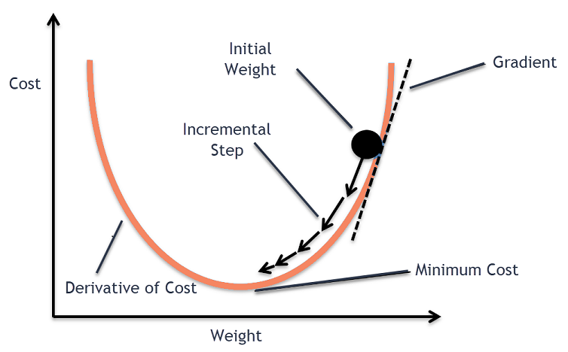
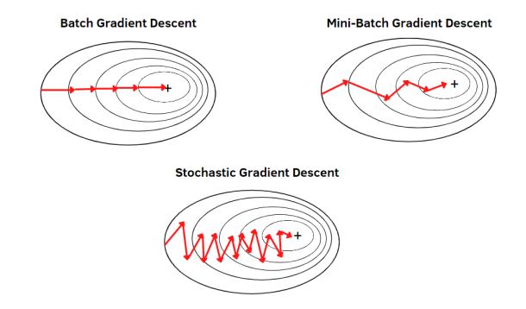
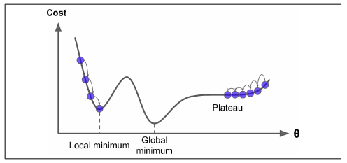

Slide 11
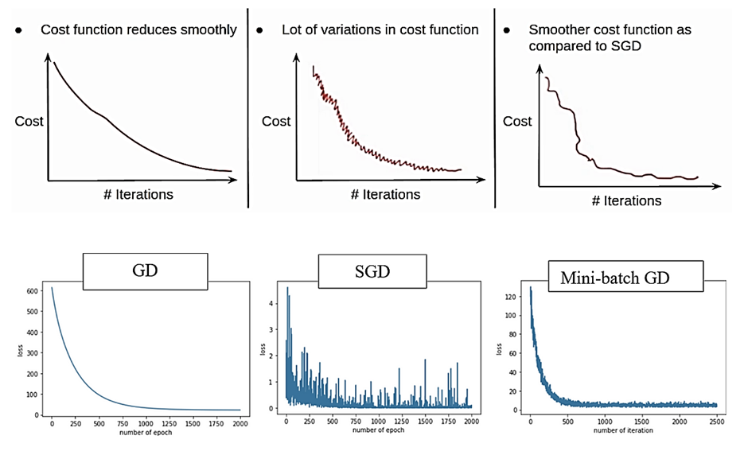

Slide 12
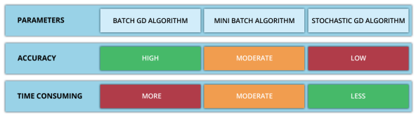
Summary
Speed:
SGD > Mini-Batch Gradient Descent > Batch Gradient Descent
Convergence Stability:
Batch Gradient Descent > Mini-Batch Gradient Descent > SGD

